Slide 1
Design Thinking Innovation
WIP- 1

Slide 2
What is Urban Farming..?
Urban farming is a system, which avoids or largely excludes the use of synthetic inputs and to the maximum extent feasible relies upon crop rotations, crop residues, animal manures, off-farm organic waste, mineral grade rock additives and biological system of nutrient mobilization and plant protection

Slide 3
Challenges:
Urban growth could become problematic in terms of feeding the population. In response to the need for food and the growing demand for local food to reduce the impact on the environment, current farming practices needed to be redesigned. Urban and peri-urban farming was the result. It consists of producing vegetables, fruit and other food or raising animals in and around cities.

Slide 4
it helps feed people in the city, produces fresh local produce, helps green cities by sequestering carbon and limiting urban heat islands, creates social ties, creates jobs, enhances the value of empty spaces, enriches the city's biodiversity, and more.

Slide 5
Learnings From Design thinking:
Gather Inspiration—Inspire new thinking by discovering what people really need. Generate Ideas—Push past obvious solutions to get to breakthrough ideas. Make Ideas Tangible—Build rough prototypes to learn how to make ideas better. Test to Learn—Refine ideas by gathering feedback and experimenting forward

Slide 6
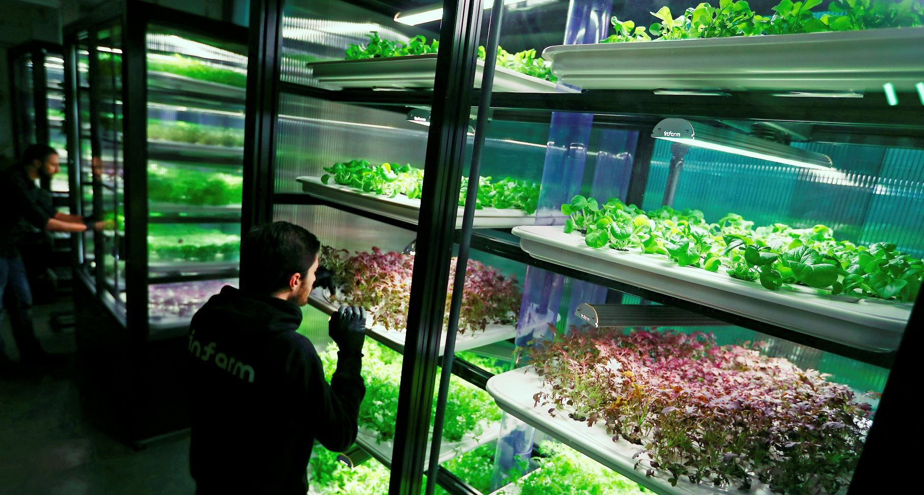
URBAN FARMING
This Photo by Unknown Author is licensed under CC BY-NC

Slide 7
CONTEXT
urban farming is a response to food and livelihood insecurity. urban farming grows a greener future because food grown locally requires less transportation . urban farms can bring greater yields in smaller areas, increase access to healthy options in urban food deserts.
IT will benefit local people and it is affordable as there are minimal transportation charges

Slide 8
Cont..
With massive urbanization fertile lands are diminishing every day. So urban farming is probable solution for efficient usage of land to feed people because roof top gardens not only take minimal space but also provides tones of fresh produce
It grows a plant in about 16 days instead of 30 days on field
That seems like enough of a reason to continue to develop this in cities.

Slide 9
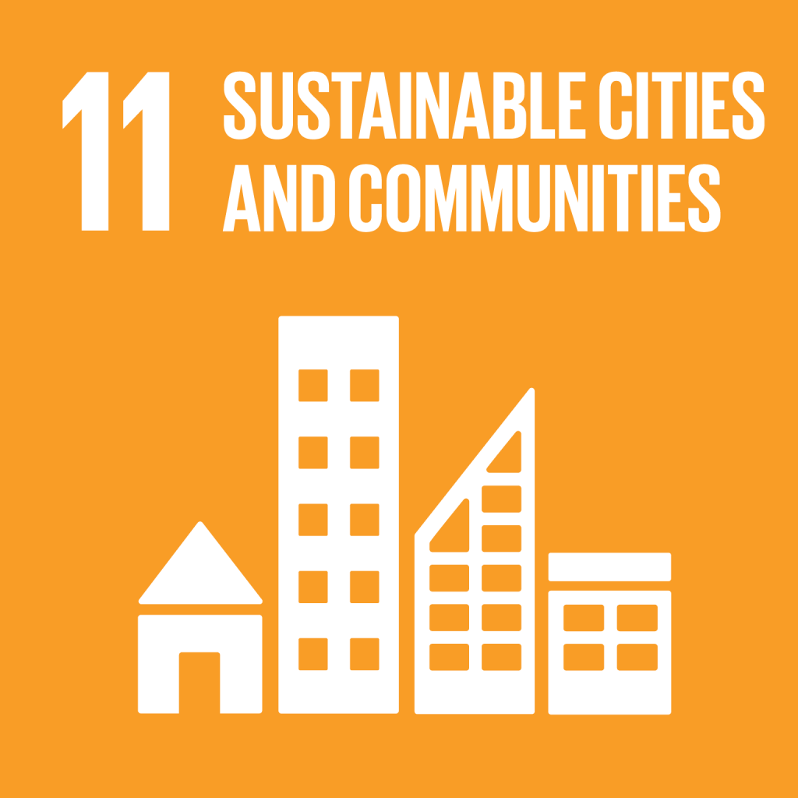
Urban farming will fulfil the Sustainable goal 11
This Photo by Unknown Author is licensed under CC BY-NC-ND

Slide 10
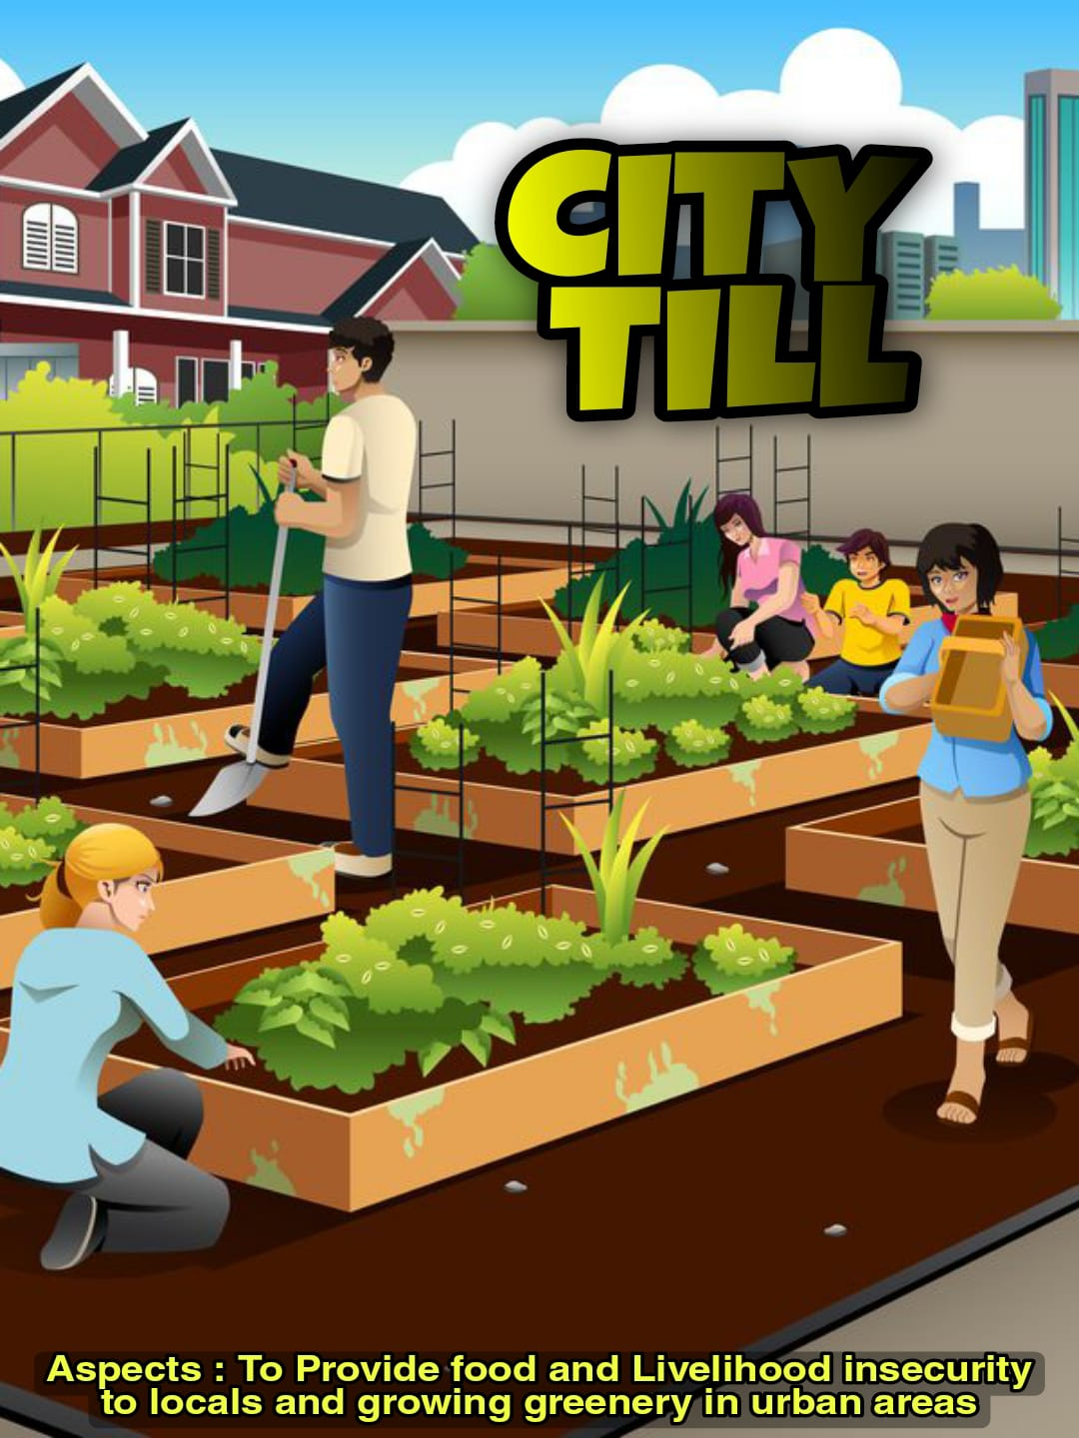
Example Nugget. City refers to urban area and Tilling means farming

Slide 11
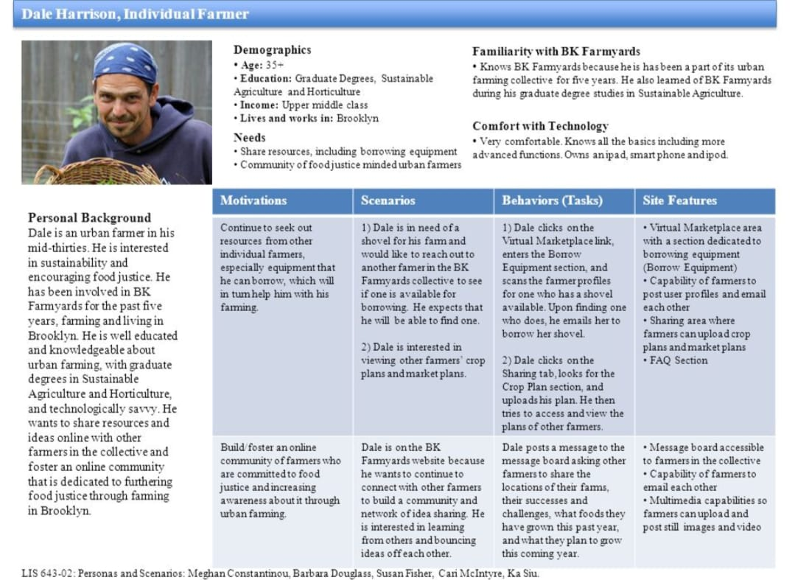
Persona about an urban farmer
.

Slide 12
PROBLEM STATEMENT
Easy accessing of food in urban areas
WHY THE PROBLEM..?
There is no proper facilities which are required for farming…
HOW WE HAVE TO SLOVE THE PROBLEM..?
We enable market access to quality seeds, crop-specific fertilizers and agricultural lime…
TO WHOM THE PROBLEM..?
In recent years there has occurred a fall in agricultural production mainly due to fall in the output of non-food articles…

Slide 13
TYPES OF URBAN FARMING
Arable: Crops
Pastoral: Animals
Mixed: Crops and animals
Subsistence: Grown just for the farmer and his family
Commercial: Grown to sell
Intensive: High inputs of labour or capital usually small
Extensive: Low inputs of labour or capital
Sedentary: Permanently in in one place
Nomadic: The farmers move around to find new areas to farm

Slide 14
What are the benefits of Urban Farming..?
It helps in keeping agricultural production at a higher level and makes it sustainable.
It reduces the cost of agricultural production and also improves the soil health.
It not only saves energy for both animal and machine, but also reduces risk of crop failure.
It helps in maintaining environment health by reducing the level of pollution

Slide 15
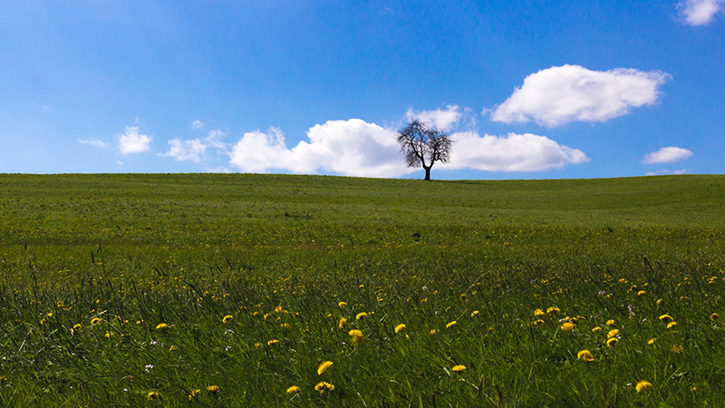
URBAN FARMING
There is a survey on Urban Farming
Date : 9th February, 2022
Venue : K L University

Slide 16
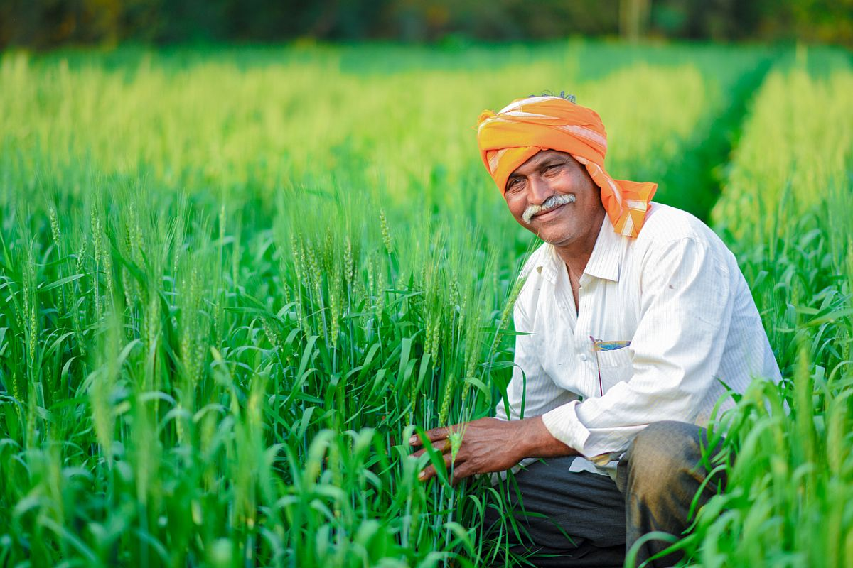
Survey for Urban Farming
1)Can you describe any environmentally friendly practices which you have used to replace
chemical pesticides?
A)Demonstrates knowledge of environmentally friendly farming practices.
2)How do you ensure the proper functioning of farm equipment?
A)Demonstrates knowledge of ensuring farm equipment is used correctly.
3)What method do you use to demonstrate and describe techniques, practices, and safety regulations to
laborers? Provide an example.
Demonstrates leadership skills and ability to demonstrate and describe farming knowledge effectively.
4)How is your ability to work under pressure?
Demonstrates time management skills and ability to prioritize.

Slide 17
Point of View About Urban Forming
Growth in agriculture remains more poverty reducing than growth
The poorest benefit most from agricultural growth
The comparative advantage of agriculture is not limited to landlocked countries
Agriculture is the main occupation. It provides employment to nearly 61% persons of total population.

Slide 18
How to solve the problems in Urban Forming..?
Seeds:
The emerging global challenges like climate change, pest resistance, herbicide tolerance, higher costs to R&D, and supply chain disruptions have made the seed industry facing challenging future…
Cropping Pattern:
There has occurred a fall in agricultural production
mainly due to fall in the output of non-food articles.
The systems and techniques of farming,
The marketing of agricultural products
The indebtedness of the farmers.

Slide 19
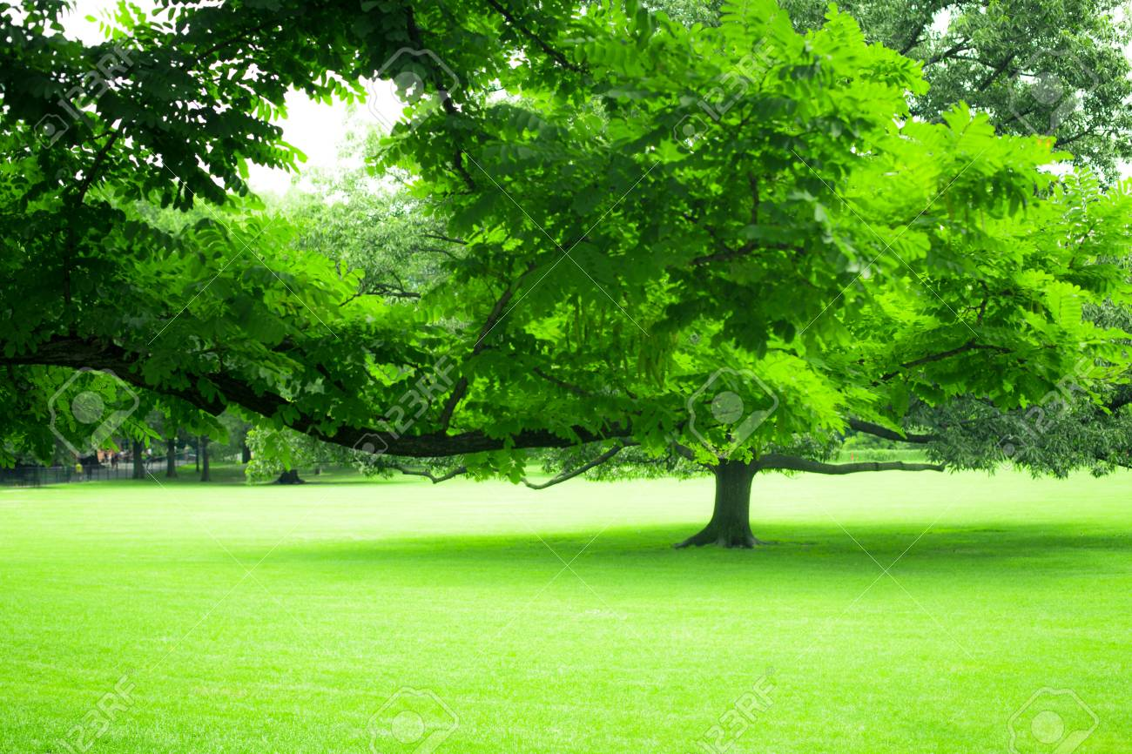
THANK YOU

